Slide 1


T4T Opleidingsdag 2015
Git
the stupid content tracker

Slide 2
Menu
PART I: Git: What, Why, When
PART II: When=Now: Setup & Basic Demo
PART III: GitHub Collaboration
PART IV: Gitflow
PART V: Git Not So Basic
PART VI: So… You have a mess on your hands
PART VII probably won't make it…
PART VIII: Final thoughts

Slide 3
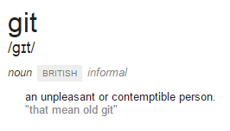
What is (a) Git
I'm an egotistical bastard, and I name all my projects after myself.
–- Torvalds

Slide 4

Git All The Things

Slide 5
Part II: When=Now: Setup & Demo

Slide 6
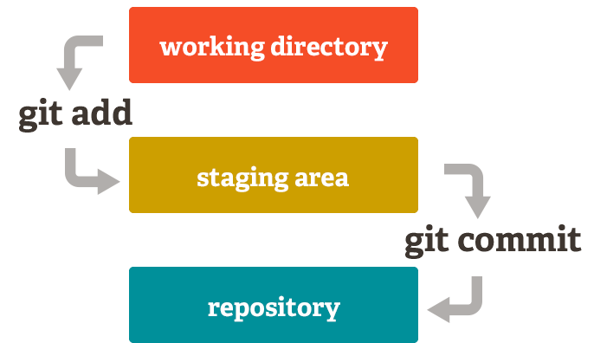
Git Basics
cd to\path
git init
git add
git commit
git push

Slide 7
Git Config
$HOME\.gitconfig
[user]
name = Barty
email = hero-bart@hotmail.com
Shell equivalent
git config --global user.name "Barty"
git config --global user.email "hero-bart@hotmail.com"

Slide 8

Let's Try it
Interactieve sessie… whoo..
Administrator PowerShell:
T4T DROPBOX\Training\Trainingsday 2015 Git\try-git.ps1

Slide 9

Part II: Github Collaboration

Slide 10
Pretty pull requests get merged

Slide 11
One commit = one thing Make the most of your commit message `git add .` and `git commit -a` are the enemies of clean commits

Slide 12
Minimum viable pull requests

Slide 13
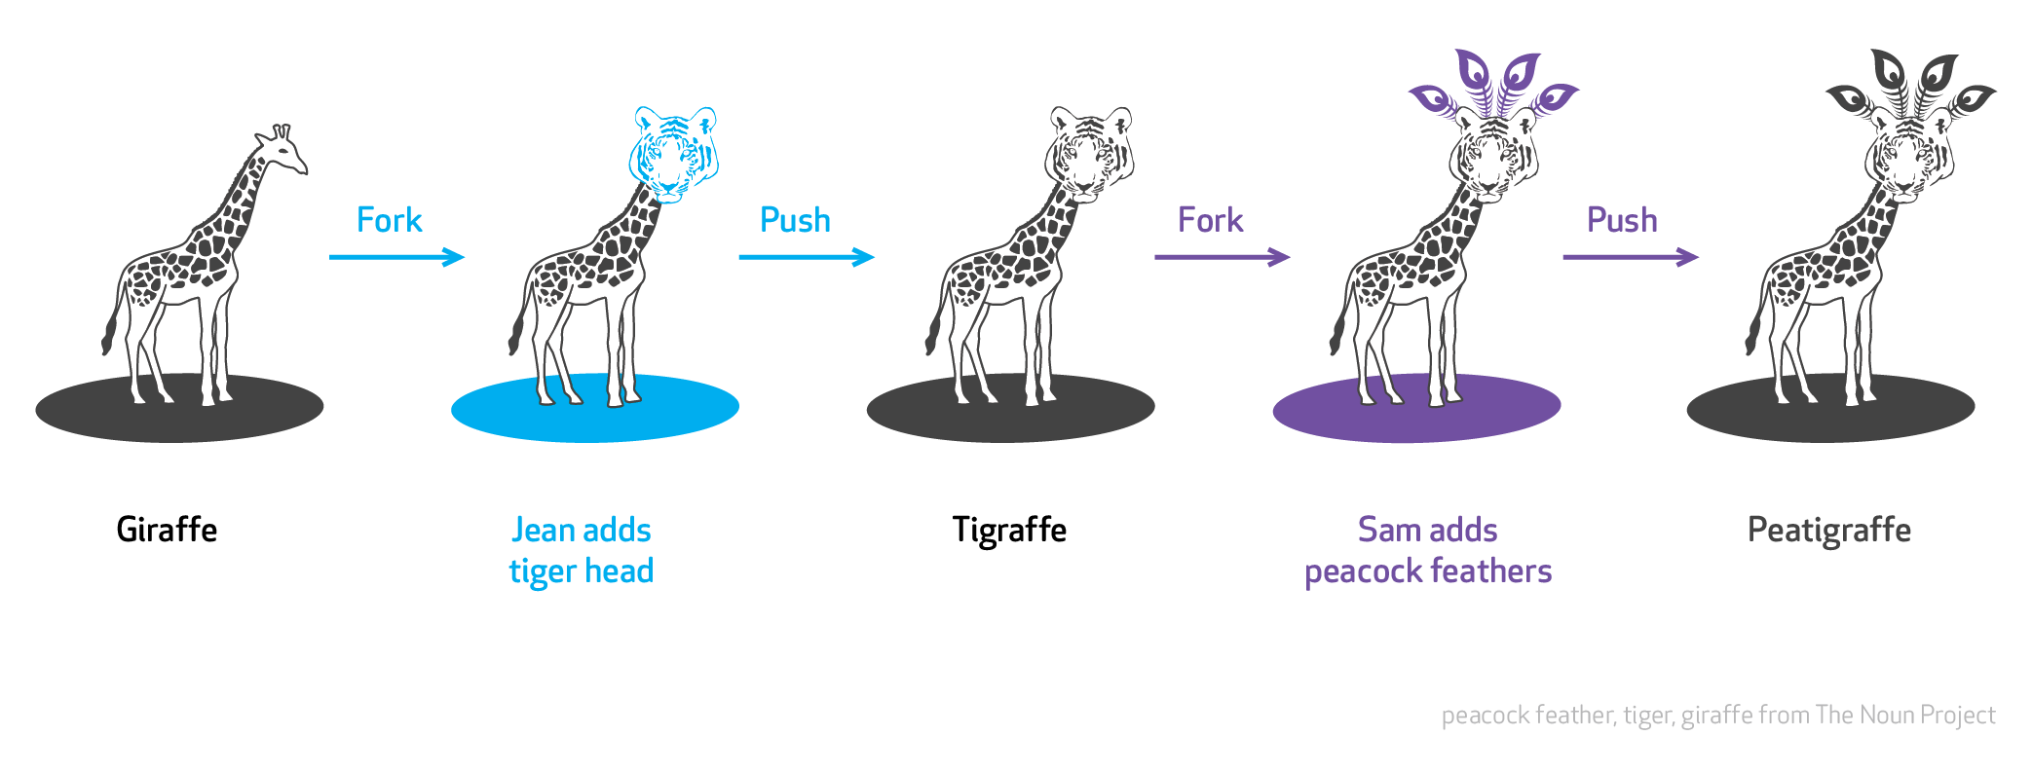
Let's Try it
Maintainers
“discuss” and “evaluate”
git fetch
git merge
“approve” or “decline”
Collaborateurs
git clone
git commit -a
git push
“pull request”
… or …
git pull

Slide 14
PART IV: Gitflow

Slide 15
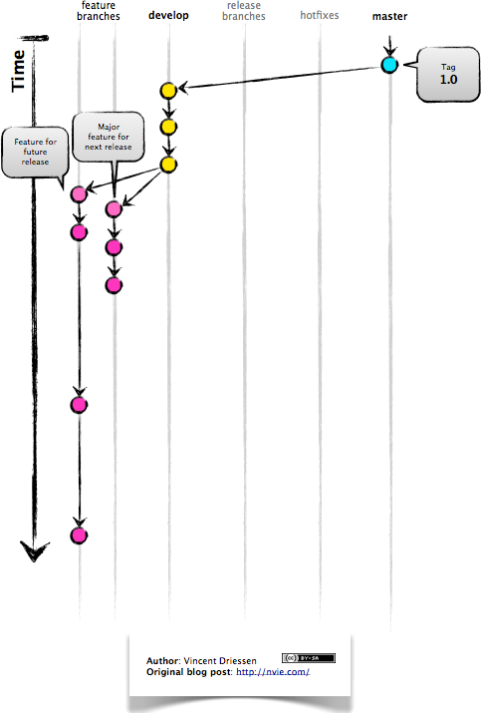
Gitflow

Slide 16
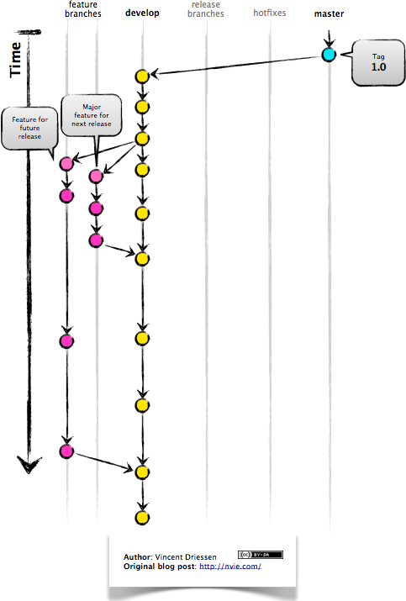
Gitflow

Slide 17
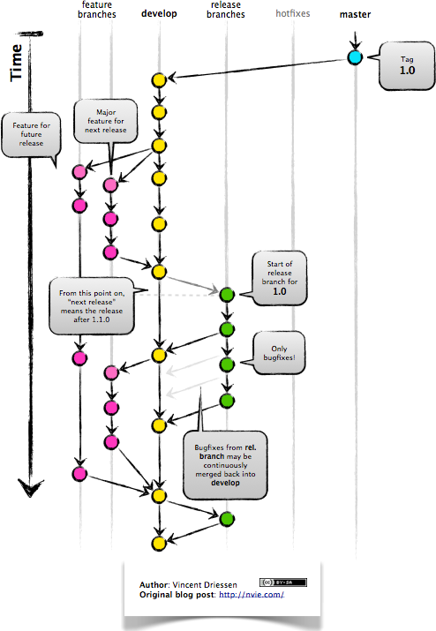
Gitflow

Slide 18
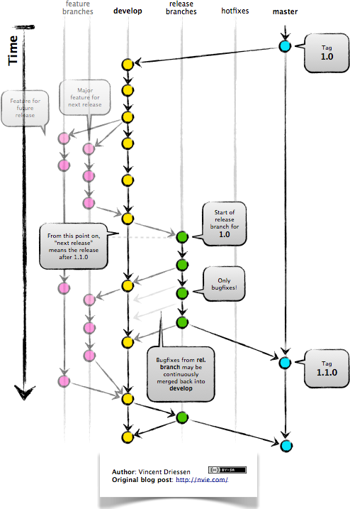
Gitflow

Slide 19
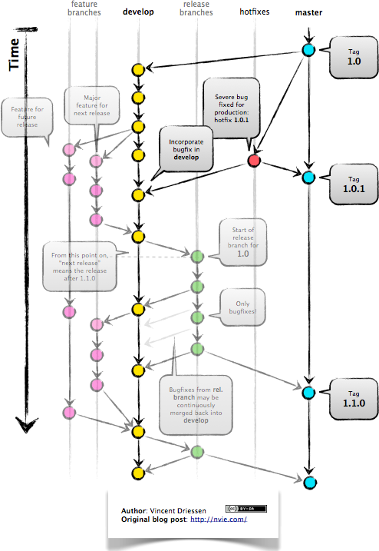

Slide 20
PART V: Git Not So Basic
More configuration
Finding commits
Changing history

Slide 21
More Configuration
.gitconfig
.gitignore + .gitignore_global
.gitattributes + .gitattributes_global
hooks → Samples in .git\hooks

Slide 22
Finding Commits
sha-1
branch@{1}
tag
HEAD~3
HEAD~2^2
F5ea4158eab1… (git log)
Previous pointer of branch (git reflog)
v1.0 (git tag)
Third parent of HEAD
git diff HEAD..HEAD^2
git checkout v1.0~2
git merge origin/master

Slide 23
PART VI: So you have a mess on your hands
We can fix that
hopefully...

Slide 24
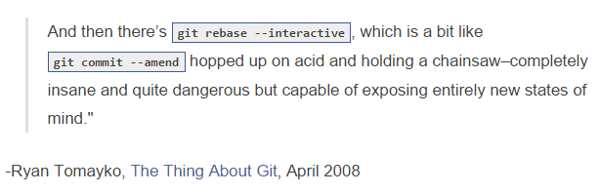
Changing History

Slide 25

Amending is fun but

Slide 26
All your base
Squash the merge commit:
git checkout development
git fetch origin
git rebase origin/development
git rebase -i HEAD~4
git rebase -i origin/develop

Slide 27
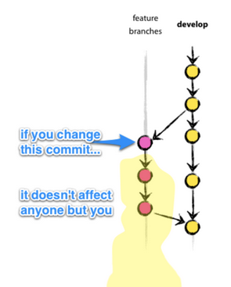
Changing History

Slide 28
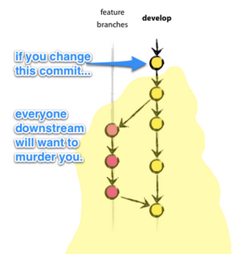
Changing History

Slide 29
PART VII: Probably won't make it
We'll have to let go

Slide 30
Merge Conflicts
<<<<<<<
Changes made on the branch that is being merged into. In most cases,
this is the branch that I have currently checked out (i.e. HEAD).
|||||||
The common ancestor version.
=======
Changes made on the branch that is being merged in. This is often a
feature/topic branch.
>>>>>>>
Look at specific side of unmerged paths:
git checkout --ours filename.c
git checkout --theirs filename.c

Slide 31
Sensitive and Personal
git update-index --(no-)assume-unchanged
gitattributes encryption filter + submodule
hooks
Internals: DAG, SHA1, .git folder, Merple tree
grep

Slide 32
PART VIII: Final Thoughts

Slide 33
What to remember
Git All Things
Especially Git folders that have brothers like _backup, _20150402 etc
Git can be strange… (It gets better with the years)
Do not rewrite published commits
Define aliases that fit your workflow
And finally:
You'll love Git (most of the time)

Slide 34
Links
Think Like (a) Git
http://think-like-a-git.net/
Git for Ages 4 And Up
https://www.youtube.com/watch?v=1ffBJ4sVUb4
Gitlfow Extensions (& link to artikel)
https://github.com/nvie/gitflow

Slide 35
Links
git – the simple guide
http://rogerdudler.github.io/git-guide/index.html
Gratis boek “Git Pro”, reference, tuts, videos:
http://git-scm.com/
Changing history https://presentate.com/bobthecow/talks/changing-history

Slide 36
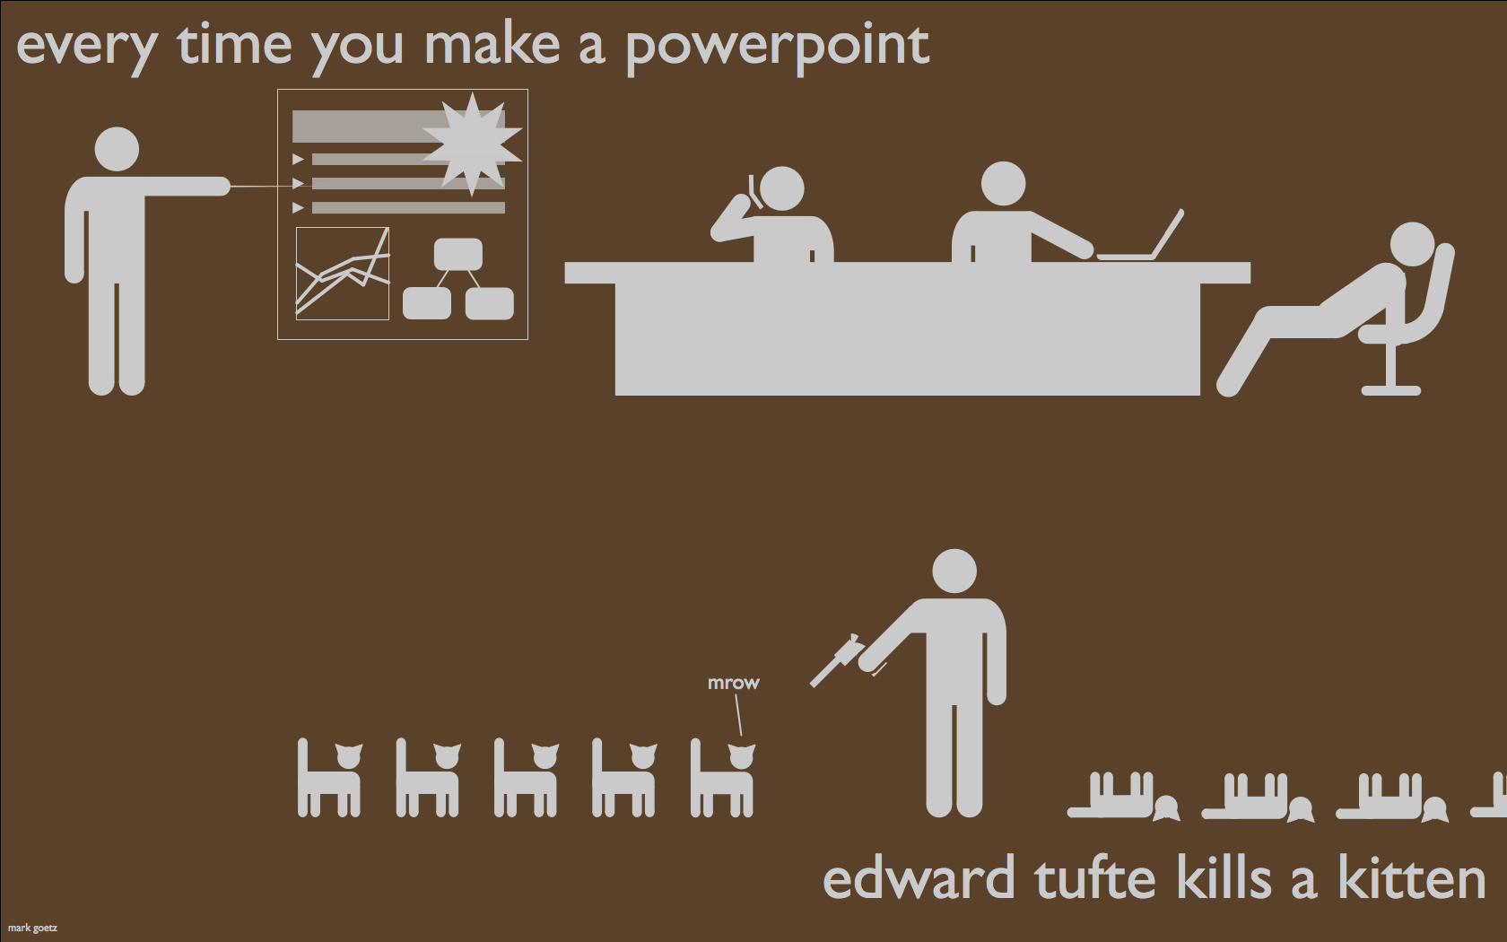
Questions?

